Slide 1
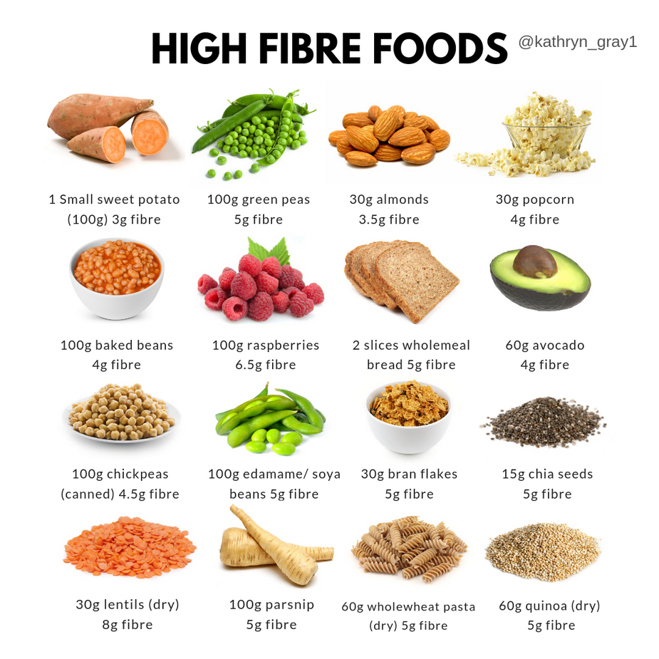

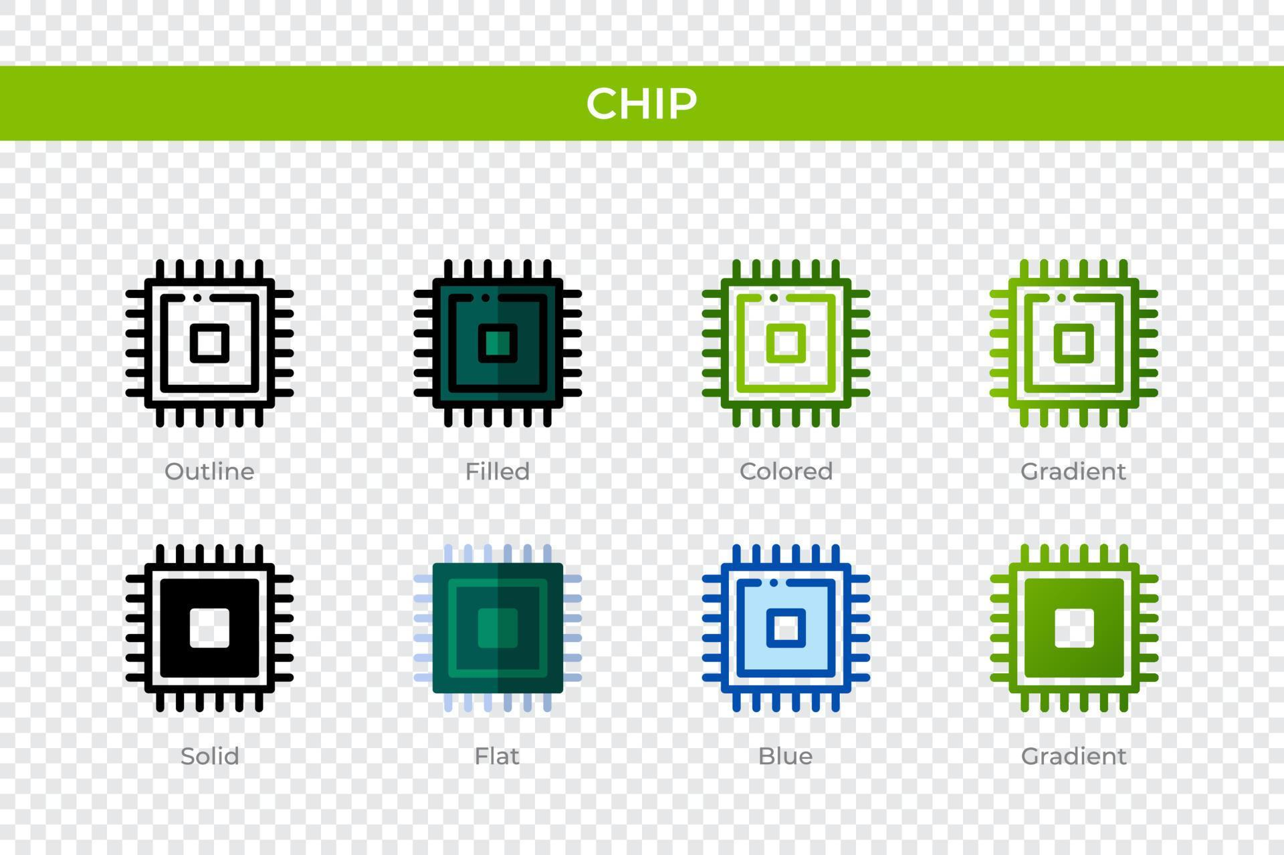

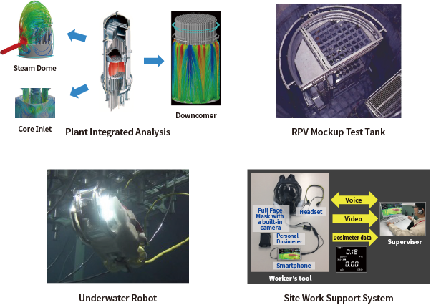

Technology Advances: Materials, Computing, Guidance
Materials: Aluminum alloys, Al-Li, composites
TPS: Ablative heat shields, arc-jet repairs
Computing: Real-time design, rad-hard processors
GNC: Inertial platforms, TRN, LIDAR
ECLSS: Digital twins, closed-loop improvements
Comms: Deep-space comms, optical links

